Slide 1


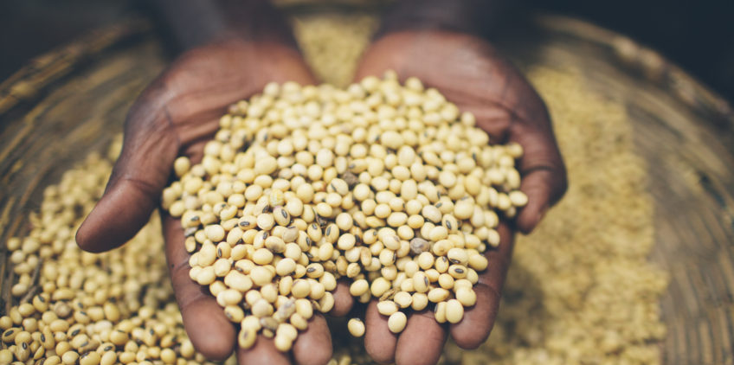


The United Republic of Tanzania
Agriculture Sector Lead Ministries
5TH ANNUAL AGRICULTURAL POLICY CONFERENCE (AAPC)
THEME:
Prioritizing Agriculture in the Industrialization Agenda for Tanzania under the
Agricultural Sector Development Program (ASDP-2)
DAY 1: TREASURY SQUARE, DODOMA
DAY 2 & 3: DODOMA HOTEL, DODOMA
13th – 15th February, 2019
Partners:

Slide 2
The Changing Face of Agriculture in Tanzania:
Indicators of Transformation
Ayala Wineman, Thomas S. Jayne, Holger Kray and Emma Isinika Modamba

Slide 3
Introduction
The process of structural transformation is widely found to occur alongside (or follow from) agricultural transformation.
Such transformation is characterized by agricultural intensification, rising labor productivity, improving access to markets, and a greater commercial orientation of farms.
Whether countries in sub-Saharan Africa are moving along the arc of transformation remains an open question.
Using the Tanzania Living Standards Measurement Study - Integrated Surveys on Agriculture (LSMS-ISA) from 2008-2014,
we examine evidence for a wide spectrum of indicators of agricultural transformation
we employ a typology of farms intended to make sense of the present-day heterogeneity found in the agricultural sector

Slide 4
1.Tanzania is experiencing a dramatic movement out of rural areas and a shift in labor away from agriculture.
Rural or agricultural status
Household income shares (mean values)
% food that is purchased (mean values)
 | All households | Agricultural households
2008 | 59.61% | 51.13%
2010 | 65.46% | 56.37%
2012 | 66.83% | 57.09%
2014 | 69.96% | 59.52%

Slide 5
2. The markets for farmland and agricultural labor are fairly active, with farmers increasingly participating.
 |  |  |  |  | Simple regression
Cropping households | 2008 | 2010 | 2012 | 2014 | Coefficient on year | P-value
Uses only family labor and non-rented land | 33% | 35% | 32% | 24% | -0.016 | 0.000
Rents in land | 12% | 8% | 9% | 16% | 0.007 | 0.001
Possesses purchased land (2014 only) |  |  |  | 38%
Hires agricultural labor | 45% | 40% | 45% | 50% | 0.007 | 0.000
Labor that is hired in | 9% | 9% | 9% | 11% | 0.004 | 0.001
Distribution of land values by year
Gini Index of land concentration
 | Among households that access land
 | Land area accessed | Land area owned
2008 | 0.59 | 0.64
2010 | 0.58 | 0.62
2012 | 0.59 | 0.65
2014 | 0.61 | 0.68

Slide 6
3. Farms are increasingly likely to engage in some (though not all) forms of agricultural intensification.
 |  |  |  |  | Simple regression
 | 2008 | 2010 | 2012 | 2014 | Coefficient on year | P-value
Cropping households
Uses a tractor | 3% | 3% | 5% | 7% | 0.007 | 0.000
Uses improved seed | -- | -- | 34% | 40% | 0.026 | 0.001
Purchased improved seed | 17% | 14% | 22% | 28% | 0.021 | 0.000
Uses fertilizer | 12% | 16% | 14% | 16% | 0.004 | 0.025
Uses pesticide | 13% | 11% | 12% | 13% | 0.000 | 0.866
Accesses agricultural inputs on credit | 1% | 2% | 2% | 2% | 0.001 | 0.274
Livestock households
Possesses an improved/exotic livestock | 14% | 19% | 15% | 11% | -0.007 | 0.004
Possesses an improved/exotic cow (among cow holders) | 5% | 7% | 6% | 4% | 0.002 | 0.222
Possesses an improved/exotic chicken (among chicken holders) | 2% | 4% | 1% | 2% | 0.002 | 0.019

Slide 7
4. Farms exhibit an increasingly commercial orientation in terms of crop production, but not necessarily livestock production.
 |  |  |  |  | Simple regression
 | 2008 | 2010 | 2012 | 2014 | Coefficient on year | P-value
Cropping households
Sells some crops | 73% | 74% | 74% | 74% | 0.002 | 0.309
% of crop value sold (mean value) | 36% | 38% | 39% | 41% | 0.008 | 0.000
% of crop value sold (mean value) if ≠ 0 | 49% | 52% | 53% | 55% | 0.009 | 0.000
Livestock households
Sells some livestock or livestock products | 64% | 60% | 61% | 64% | 0.001 | 0.833
% of livestock value sold (mean value) | 31% | 28% | 30% | 31% | 0.000 | 0.887
% of livestock value sold (mean value) if ≠ 0 | 48% | 47% | 48% | 48% | 0.000 | 0.996
Among crop sellers:
Sells crop at the farm (if sells crops) | 57% | 64% | 64% | 67% | 0.015 | 0.000
Distance to site of crop sale (km, mean) | 3.38 | 3.59 | 3.55 | 4.52 | 0.177 | 0.147
Distance to site of crop sale (km, mean), if ≠ 0 | 7.95 | 10.01 | 10.00 | 13.86 | 0.892 | 0.007

Slide 8
5. The agricultural sector has grown in size, reflecting a remarkable area expansion (although labor productivity has also improved).
Total value of agricultural output
Total land area cultivated
Land and labor productivity (country-level, main season)
 | 2008 | 2010 | 2012 | 2014
Value crop production (billions shillings) | 3,211,084 | 3,889,921 | 4,505,868 | 5,134,865
Area cropped (ha) | 8,301,139 | 9,446,337 | 10,497,865 | 12,997,240
Value crop production / ha cropped (millions shillings) | 0.387 | 0.411 | 0.429 | 0.395
Total labor days on farms (millions) | 811 | 894 | 947 | 1,083
Value crop production / labor day (shillings) | 3,962 | 4,353 | 4,756 | 4,742
Labor intensity (days / ha) | 97.56 | 94.50 | 90.13 | 83.33
Land productivity remains unchanged

Slide 9
6. There has been an increasing emphasis on food crops. Farms are also more likely to specialize.
Area allocations among crop groups (country level)
 |  |  |  |  | Simple regression
All farms | 2008 | 2010 | 2012 | 2014 | Coefficient on year | P-value
Proportion farm income from: (mean values)
Field/food crops (incl. cereals, legumes and oilseeds) | 0.62 | 0.62 | 0.60 | 0.64 | 0.003 | 0.106
Fruits and vegetables | 0.09 | 0.08 | 0.07 | 0.07 | -0.003 | 0.001
Cash crops (traditional) | 0.08 | 0.09 | 0.10 | 0.06 | -0.002 | 0.018
Livestock | 0.21 | 0.21 | 0.22 | 0.22 | 0.002 | 0.138
Farm specializes in one category of farm output | 62% | 63% | 64% | 66% | 0.006 | 0.010

Slide 10
Typology of farms
The perception of a Tanzanian farm sector dominated by subsistence-oriented smallholders is changing slowly.

Slide 11
Medium-scale farms and small, farm-focused, commercialized farms are claiming an increasingly prominent role.
Farm category distribution
Distribution of land cultivated, by farm category
Distribution of agricultural production value, by farm category

Slide 12
Application of this farm typology sheds light on the farming population and patterns of production.
Income shares
Income levels
 | Small |  |  |  | Medium | Large
 | On-farm focus |  | Off-farm focus
 | Not com. | Com. | Not com. | Com.
Uses only family labor and non-rented land | 38% | 24% | 35% | 25% | 14% | 10%
Rents in land | 10% | 13% | 13% | 18% | 7% | 3%
Possesses purchased land (2014 only) | 33% | 38% | 37% | 32% | 60% | 55%
Hires agricultural labor | 37% | 48% | 44% | 56% | 61% | 65%
Labor days hired in (mean value) | 8.59 | 17.57 | 10.26 | 16.91 | 49.37 | 64.25
% of total agricultural employment in the country | 20% | 25% | 13% | 8% | 31% | 4%
Uses a tractor | 4% | 5% | 5% | 7% | 7% | 7%

Slide 13
Concluding thoughts
We find evidence of change along several axes:
Agricultural sector is growing, ↑ intensification, ↑ factor market engagement, ↑ commercialization…
This nuanced typology of farms reveals:
Rise of medium-scale farms in importance
Decline of farm-focused, non-commercialized farms
People are de-emphasizing or exiting agriculture and moving to cities, as poverty rates are falling.
This is consistent with the notion that agricultural growth plays a vital role in structural change, strengthening the non-farm economy through backward and forward linkages, and enabling people to securely exit agriculture.

Slide 14
Concluding thoughts
These findings underscore the vital importance of continued/increased support for agriculture (especially productivity growth) as a catalyst for structural transformation and inclusive economic growth.
Question: Will these trends be sustained post 2015 given the recent decline in investments in agriculture?
Heterogeneity among farms and the rapidly shifting distribution of farm categories propose that policy attention should be directed to meeting farmers' diverse needs. Agricultural investments should be targeted among the diverse farming population in order to achieve their distinct objectives.

Slide 15

Asanteni Sana
Thank you!

